Slide 2
First Normal Form (1NF)
Rules
A relation will be 1NF if it contains an atomic value.
It states that an attribute of a table cannot hold multiple values. It must hold only single-valued attribute.
First normal form disallows the multi-valued attribute, composite attribute, and their combinations.

Slide 3
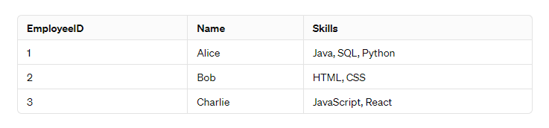
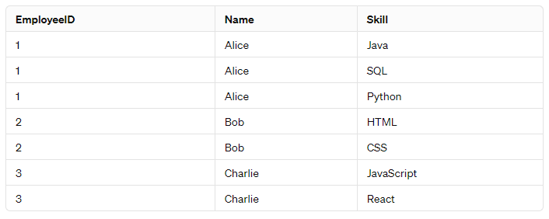
Example:
For example, consider a table storing employee data:
This table is not in 1NF because the "Skills" column contains multiple values separated by commas, violating the atomic values rule. To bring it into 1NF, you would split the skills into separate rows, like this:
Now, each cell contains only a single value, and there are no repeating groups of columns. This table conforms to First Normal Form (1NF).

Slide 4
Second Normal Form (2NF)
It should be in the First Normal form.
And, it should not have Partial Dependency.

Slide 5
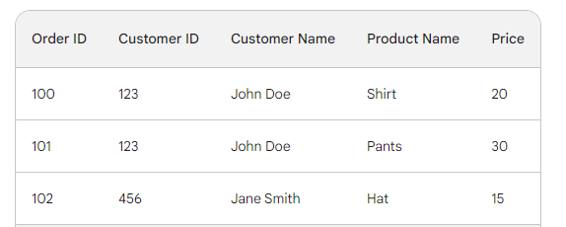
Example
Imagine a table storing order information:
This table is in 1NF, but it violates 2NF. Why? Because the "Customer Name" attribute depends only on the "Customer ID," which is a subset of the possible candidate key (both "Order ID" and "Customer ID" together could uniquely identify an order).

Slide 6
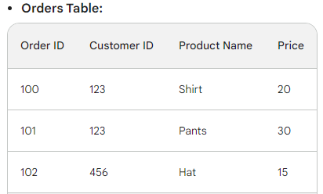
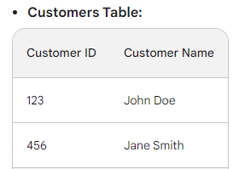
Example cont..
Normalization to 2NF:
To achieve 2NF, we create a separate table for customer information:

Slide 7
Third Normal Form
In 2NF:
The table adheres to all the rules of 2NF, meaning there are no partial dependencies and all non-key attributes rely solely on the entire primary key.
No Transitive Dependencies:
There are no non-key attributes that are dependent on other non-key attributes. In simpler terms, any non-key attribute must be directly determined by the whole primary key, not indirectly through another non-key attribute.

Slide 8
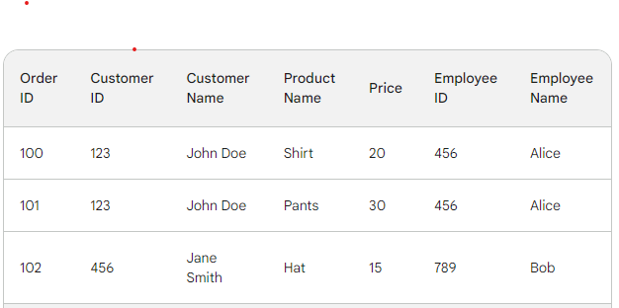
Example:
Imagine a table storing order information:
This table is in 2NF, but it violates 3NF. Why? Because "Employee Name" is dependent on "Employee ID," which is a non-key attribute. "Employee Name" should solely rely on the primary key (likely "Employee ID").

Slide 9
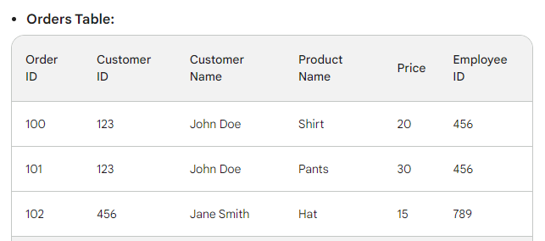
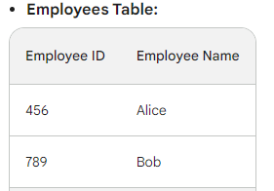
Example cont...
Normalization to 3NF:
To achieve 3NF, we create a separate table for employee information:
Now, "Employee Name" is directly determined by the "Employee ID" in the Employees table, satisfying the requirement of 3NF.

